Slide 1

Arizona Water Availability Analysis
100 Year Plan
Robin Stewart
Data Scientist
Notes:
My name is Robin Stewart and I am a data scientist and I’m here to present my analysis of Arizona’s future water availability

Slide 2
Arizona Water Summary
Sources and USES of WATER.
Arizona existing water plan.
When does Arizona run out of water
Notes:
First we’ll go over the sources and uses of water, the Water Management plan enacted in 1980, yes, forty years ago, and finally talk about the availability of water in the long term

Slide 3
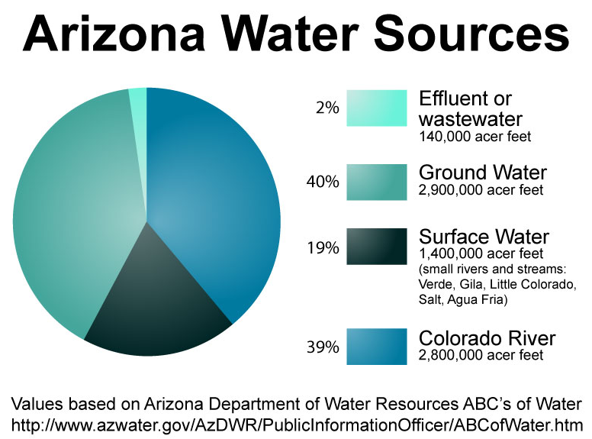
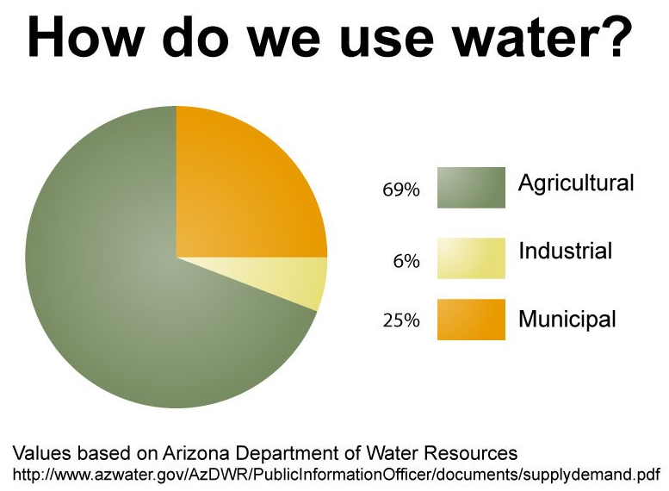
Sources & Uses of Water
Arizona uses over 7 million acre-feet of water in a year. 1 acre-foot = 325,851 gallons
Notes:
until this year, Arizona has gotten 40% of its water from the Colorado River, another 40% from the aquafer, and those are the main sources we’ll be looking at today.

Slide 4
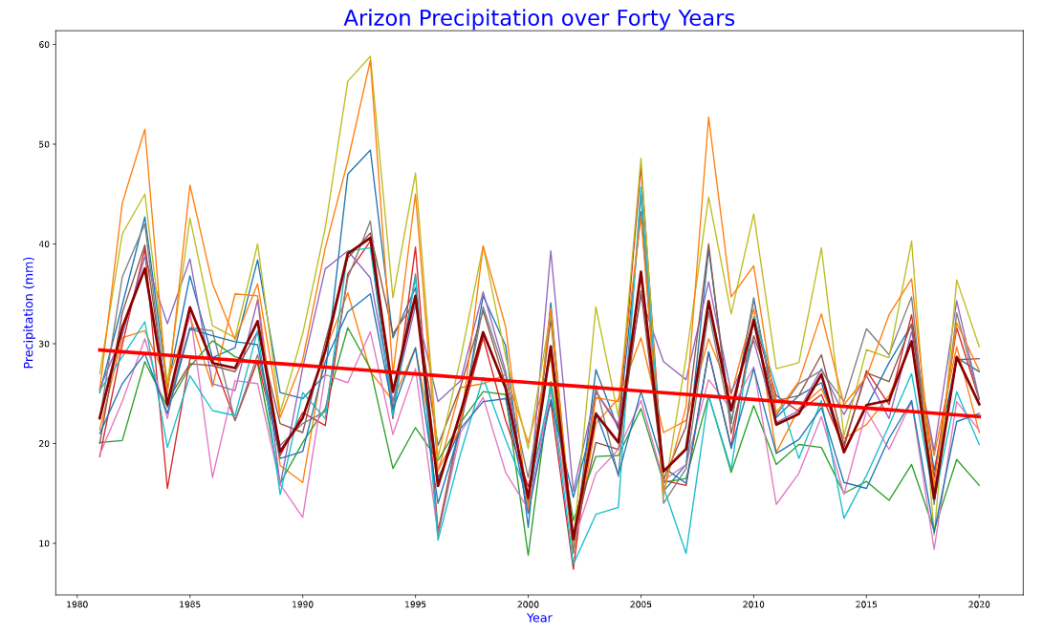
Notes:
It doesn’t rain a lot in AZ. What we’re looking at in this graph is forty years of precipitation from weather stations all over the state. You can see there’s a wide variety due to data collections in mountain areas like flagstaff as well as sealevel desert areas like Phoenix. The dark read line is the mean line, and the straight line is the best fit line to show the 40-year trend.

Slide 5
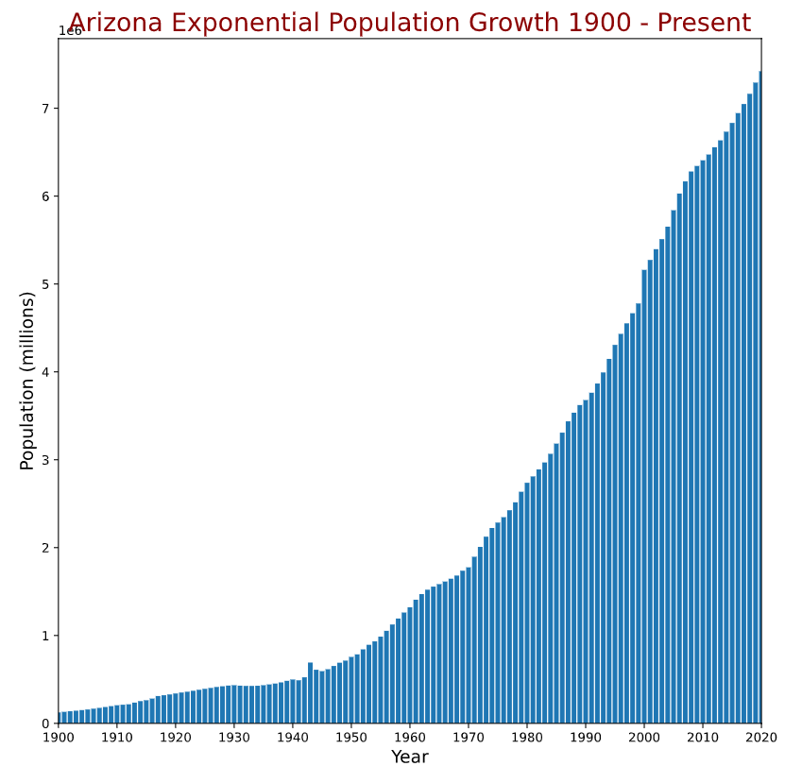
Arizona Population
Seven million in AZ
Five million in Greater Phoenix
Growing between 1.5 – 1.8% each year
Data source: macrostrends.net
Notes:
Another consideration of water needs is population. I graphed over one hundred years of census data to show the exponential growth in AZ. If you look at where we were in 1980 when the water plan was devised, it’s about 1/3 of where our population is today.

Slide 6
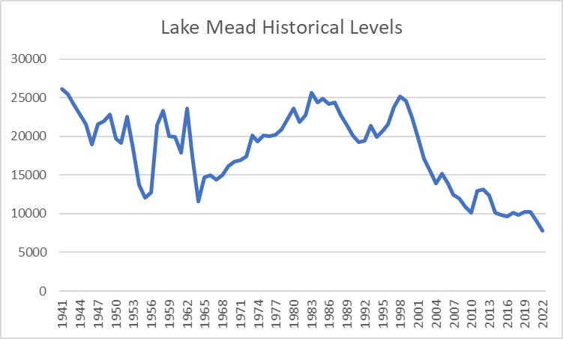
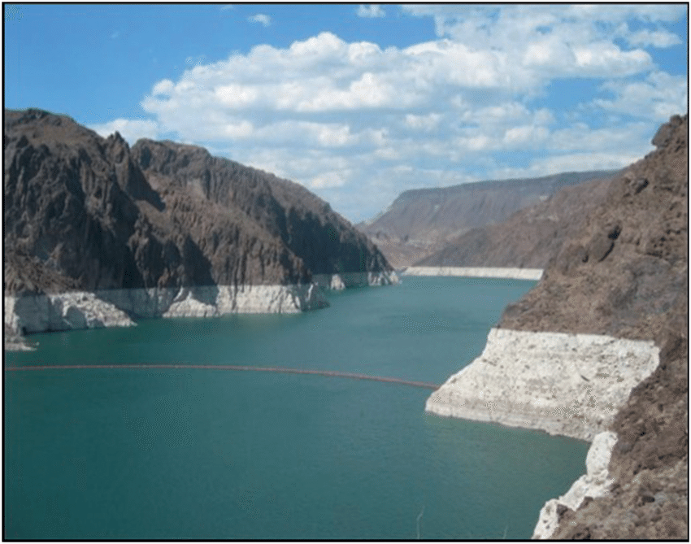
Colorado River – Lake Mead
End-of-water-year (Sept. 30) storage in Lake Mead and Lake Powell, in thousands of acre feet, Source: USBR
Notes:
Getting back to our water sources, we first have to talk about Lake Mead because it’s big news in AZ. Lake Mead is currently at its lowest historical level, low enough to trigger a tier 1 water crises. I did a really simple line graph to show you how low we’ve dipped in 20 years.

Slide 7
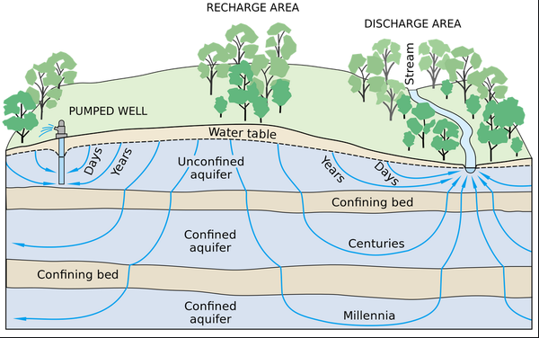
Arizona Impact of Curtailment
-Reduction of 933,333 acre-feet of water
-Deficit will come from aquifer
-How much water do we actually have?
Notes:
A tier-1 water crisis triggers a serious curtailment of water flowing to Arizona. Arizona has junior water rights, so it’s the first to take a cut, and the cut is massive, 1/3 of our normal flow. How will AZ make up for losing almost a million acre feet of water? It has to come from the aquafers, the only other source that can fill the gap

Slide 8
Aquifer Assessment
 | Water Level Chg | Wells Decreasing | Well Count | w/o Phoenix AMA
20-year | 3769 | 58% | 1245 | -5459 | 67% | 607
10-year | -2735 | 62% | 1024 | -4057 | 67% | 797
1-year | -495 | 58% | 1235 | -537 | 60% | 969
- 58% of wells declined but the 20-year assessment showed an increase that was statistically significant…why?
- Both 10 yr and 1 yr comparisons showed a statistically significant decline in water levels
 | All Wells |  | w/o Phoenix
 | t | p | t | p
20-year | 0.4698 | 0.6385 | -0.8862 | 0.3757
10-year | -0.3339 | 0.7385 | -0.5515 | 0.5813
1-year | -0.0528 | 0.9579 | -0.0628 | 0.9500
Notes:
I looked at thousands of metered wells in 46 basins. You can see from the table that the majority of wells had a reduction in water level. Two of the three periods had a net loss, with the twenty year period showing a net gain, even though a majority of wells show a decline. I investigated the anomaly and the Phoenix Basin was an extreme outlier as Arizona has been recharging that aquifer for years from our allocation of the Colorado River.
Looking at the p-values in my chart, you can see that I do not have enough significance to reject my null hypothesis, which is that there is no difference in water levels in any of the studied periods. I ascribe this finding to the variety of wells surveyed from all over the state. My next step would be to examine the wells in each basin. By focusing at the basin level, I would seek to reduce my standard error to gain more significance in sample comparisons.

Slide 9
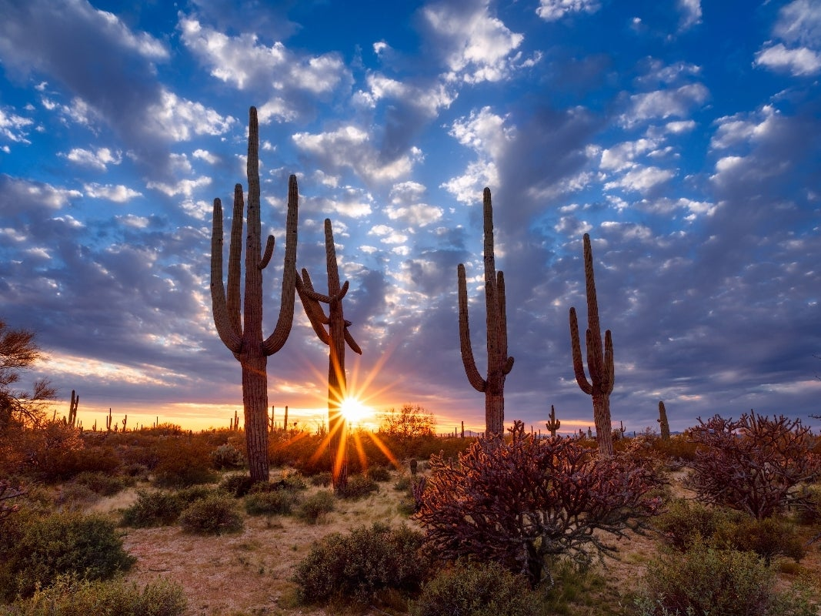
Key Findings
Arizona’s 100-year water plan Groundwater Management Act (GMA) designed to protect groundwater resources enacted in 1980
Hundreds of private wells are unmetered and unregulated
CAP has 100-year obligation (contracts) to replenish ground-water
In 1980, climate change was not a reality, the Colorado River source was dependable
Notes:
In summary, I believe that Arizona is facing a water crisis. Further investigation into the aquifer is needed, and additional well sampling after the Colorado curtailment takes effect. Thank you for your time, and I welcome any thoughts or questions you might have.

Slide 10
Appendix

Slide 11
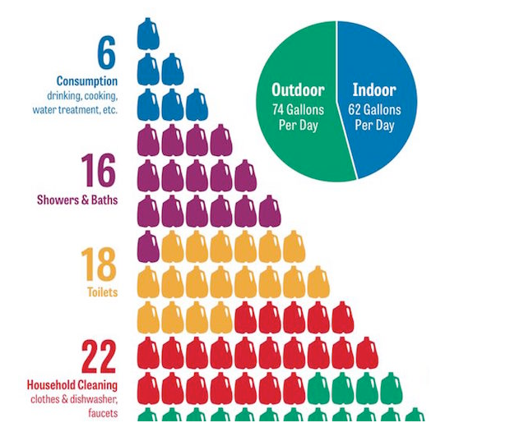
How much water do people use?
33% of Arizona households have pools – highest per capita pool ownership in US
Medium-sized hotel pool loses 1500 gallons a day to evaporation
Average home pool loses 2000 gallons / month
Phoenix has one of the highest water usages in US
Data source: statista.com
Notes:
You might think that Arizonans, living in a dry climate, would use less water than other states. In fact, the opposite is true, based mostly on our high per capita ownership of pools. If you live in a hot, dry place, of course you are going to want a pool.

Slide 12
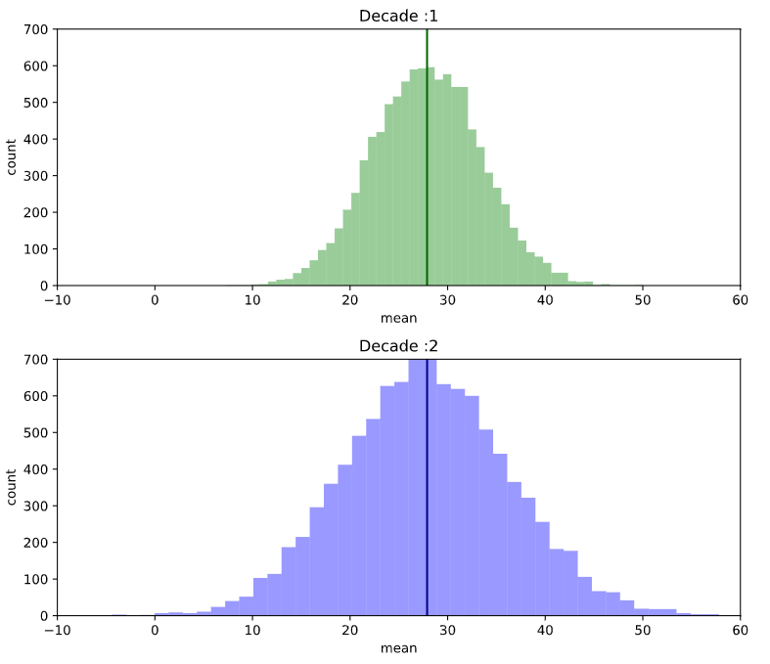
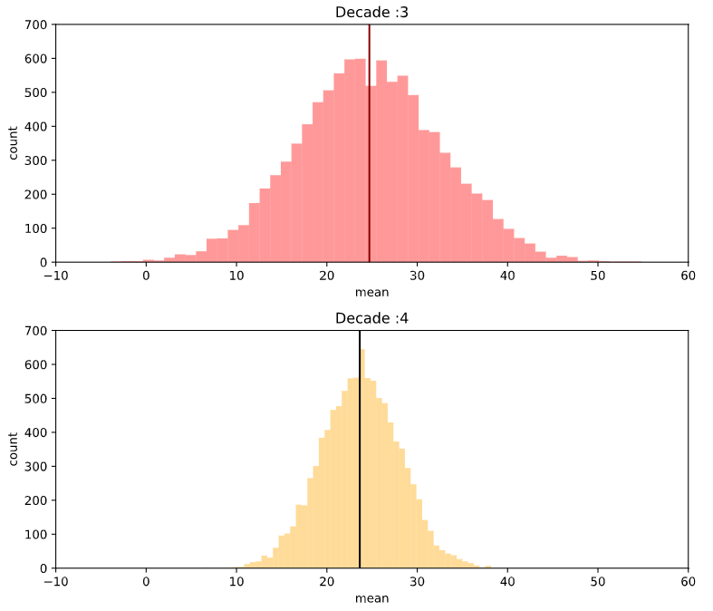
Precipitation Analysis
1 Decade to Last Decade p-value: 0.08699582881507466
2 Decade to Last Decade p-value: 0.19416225315164418
3 Decade to Last Decade p-value: 0.7313857541194515
Notes:
I modeled the rainfall comparing each decade to our most recent decade to see if there was a statistical difference in rainfall, and not just normal weather variance. You can see that each test did not meet the standard of significance, so we are not able to reject the null hypothesis that the rainfall has declined significantly.

Slide 13
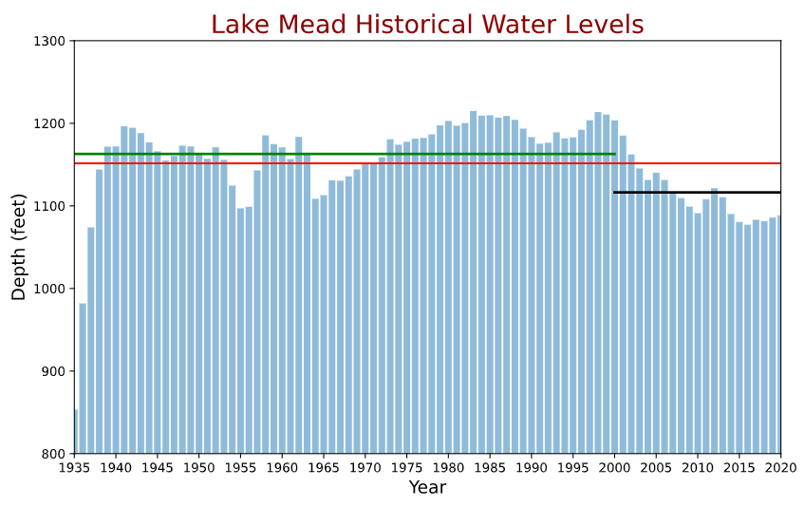
Lake Mead Historical Water Levels
- red line depicts mean for entire timespan
- green line depicts mean until 2000
- black line depicts mean for past twenty years (mega drought)
Notes:
Here I took the same data and plotted bars with three mean lines, the top line is the last century mean, the red line is for the whole sample, and the black line, significantly lower, is for the past twenty years, what climate scientists are calling a mega drought.

Slide 14
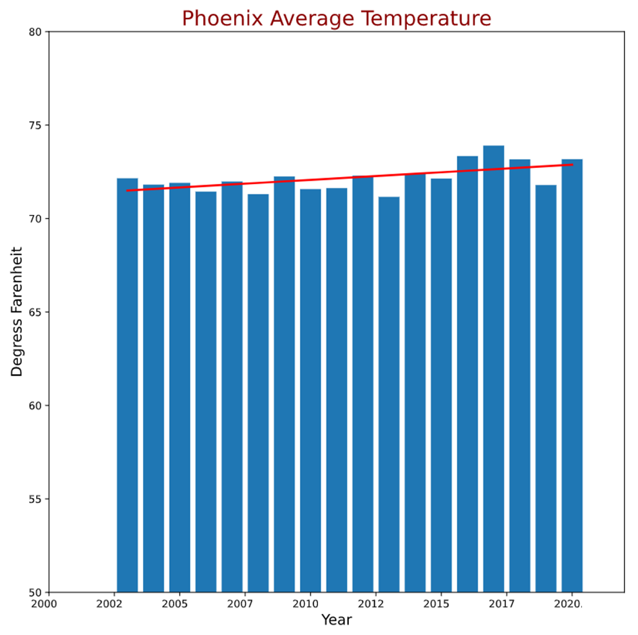
Climate
Hot and getting hotter
Rain is scarce
Notes:
Arizona’s climate is what drives water scarcity. Arizona has always been a hot dry place, and over time, it’s getting hotter and drier. Here I looked at the temperature gain in Phoenix.

